Slide 1
Project on
AGRO MARKET SYSTEM

Slide 2
Title of project: “FARMIGOS”
Introduction:
“FARMIGOS” is an e-commerce website that connects farmers and customers directly. Our website allows farmers to create profile and list their products for sale. Customers can browse the selection for products and make purchases directly through the website. By connecting farmers and customers directly , they can avoid middleman and we can help to support the local agriculture.

Slide 3
Objective of the project:
The main objective of this system is to provide virtual platform for the farmers, customers.
Both the farmer and the customer can avoid the middleman and can sell and buy the products through online.
Farmers can sell their products through online with affordable price.
Customer can buy the products according to their needs.

Slide 4
Project category:
Web-based application using rdbms.
Languages to be used:
Front-end: html, css, javascript
Back-end: mysql, php

Slide 5
Hardware interface:
Processors : intel core i3 or above
Ram : 2gb and above
Hard disk utilization : 40gb and above
Input devices : mouse, keyboard
Software interface:
Browser : internet explorer, google chrome, mozilla firefox
Server : apache
IDE : Visual Studio Code

Slide 6
Module description:
Admin:
Login: Admin will enter the website using username and password. He can Login through his email and password.
Add location: Admin can add new locations such as new cities or regions where the farmers can register.
Manage category: Admin will Add the new categories such as type of crops . It can help to farmers to add products based on category of product and also helps customer to find the products easily.
Manage farmers: This feature allows the admin to manage farmers who sales products to this website. He can view the information about farmers and can also delete the farmers account if he wants.
View customers : This feature allows the admin to manage customers who use this website to purchase products. He can view the information about customers like name , email etc. and can also delete the customers account if he wants.
View payment: The admin can view the all the payment history made by customer for purchases including customer name , product name , paid amount etc.
View feedback: The admin can view the feedback submitted by the customer for farmers about the purchases he made.
View Report: Admin can view the monthly report of the farmers like total purchases of products, total amounts etc .
Manage Blog: The admin can add new blog posts to the website, such as news or update about the agriculture industry.
View Contacts : Admin can view the feedback submitted by customers about this website.

Slide 7
Farmer:
Register: Farmers can register on the website by creating a profile with their personal and business information, such as name, location etc.
Login: the farmer can log into this website using registered his/her username and password.
View profile: Farmers can view and their profile, including their personal and business information.
Add product: Farmers can add new products for sale, including details such as product name, description, price, and photos.
Manage order: Farmers can manage the orders placed by customers like updating the status of orders.
View payment: Farmers can view the payment details made by customers, including name of customer, product name, transactions mode etc.
View feedback: Farmers can view the feedback submitted by customers, including suggestions or complaints about their products or services.
Report: Farmer can generate Monthly reports of their product purchases, transaction made by customer for his product etc.

Slide 8
Customer:
Registration: Customers can register on the website by creating a profile with their personal information, such as name, email, and address.
Login: Customers can log in to their account using their registered email address and password.
Manage profile: Customers can manage their profile, including their personal information, saved addresses.
View blog : customers can view the blog section of the website to read about relevant topics which is published by admin of this website.
Filter by location: Customers can filter the products by location, such as city or state, to find products that are available in their area.
Filter by category: Customers can filter the products by category, such as fruits, Commercial crops, or feed crops etc, to find products that match their preferences.
View products: Customers can browse through the products available on the website, including details such as product name, description, price, and photo.
Add to cart: Customers can add products to their cart and manage the quantity of each item.

Slide 9
Place order: Customers can place orders for their selected products, which are available in cart.
Payment: Customers can make payments for their orders using various payment methods, such as debit card, or Upi payment, or cash on delivery.
Track order: Customers can track the status of their orders, including the progress of their order.
Feedback: Customers can provide feedback to the farmers about their purchases like, about the quality, services etc.
Contact: customers can contact the admin of the website for any questions or concerns about the website, or the services.

Slide 10
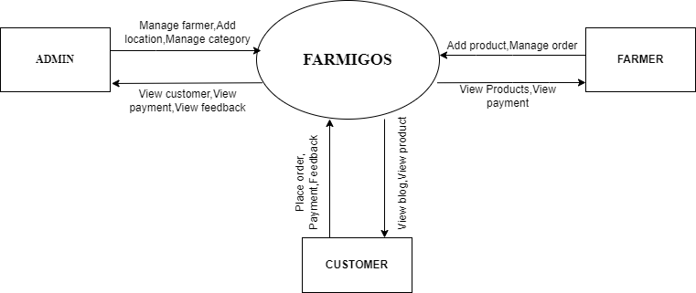
Control Flow Diagram(CFD)
Context flow diagram is a top level data flow diagram. it only contains one process node that generalizes the function of the entire system in relationship to external entities. In context diagram the entire system is treated as a single process and all its inputs, outputs, sinks and sources are identified and shown.

Slide 11
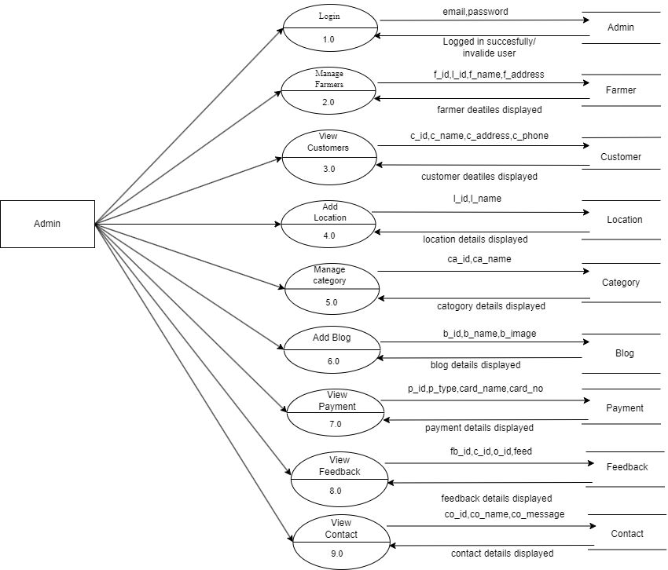
Data Flow Diagram(DFD)-Admin
data flow diagram is a graphical representation of a system or a portion of the system. It consists of data flows, process, sources and sink and stores all the description through the use of easily understandable symbols.

Slide 12
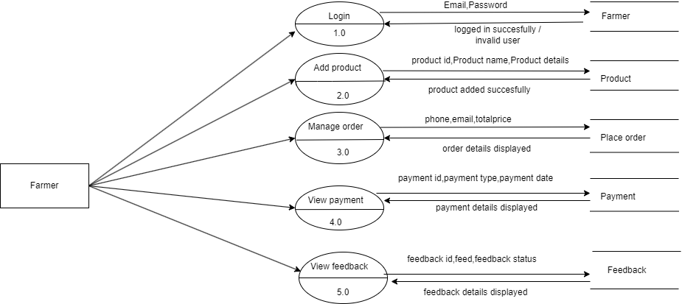
Data Flow Diagram(DFD)-Farmer
Data flow diagram is a graphical representation of a system or a portion of the system. It consists of data flows, process, sources and sink and stores all the description through the use of easily understandable symbols.

Slide 13
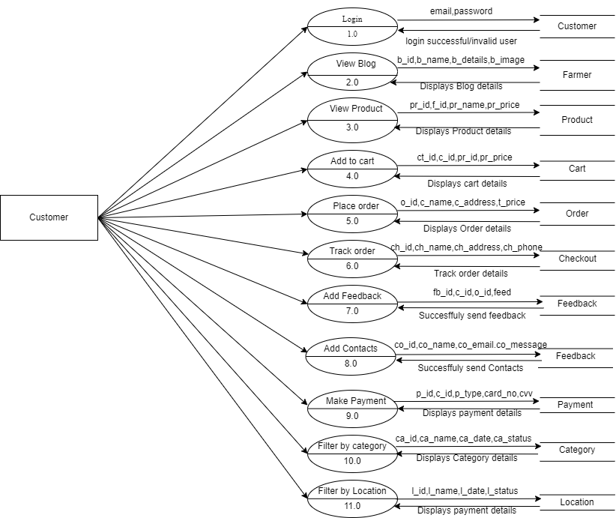
Data Flow Diagram(DFD)-Customer
data flow diagram is a graphical representation of a system or a portion of the system. it consists of data flows, process, sources and sink and stores all the description through the use of easily understandable symbols.

Slide 14
Entity Relationship Diagram(ER-Diagram)
The basic objective of the ER model representation is an entity which is a “thing” in a real world with an independent existence. Entities are physical items or aggregations of data items that are important to the business we analyze or to the system; we intend to build. An entity represents an object defined within the information system about which you want to store information. Entities are named as singular nouns and are shown in rectangles in an er-diagram. Each entity is described by several attributes; individual instances of an entity will have different attribute values.

Slide 15
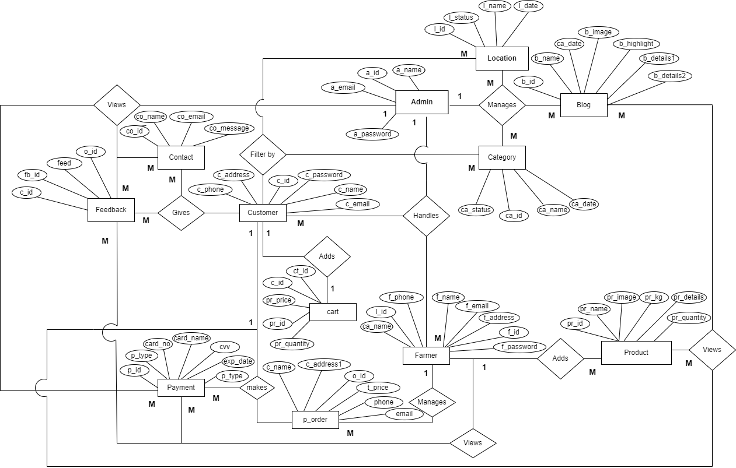

Slide 16
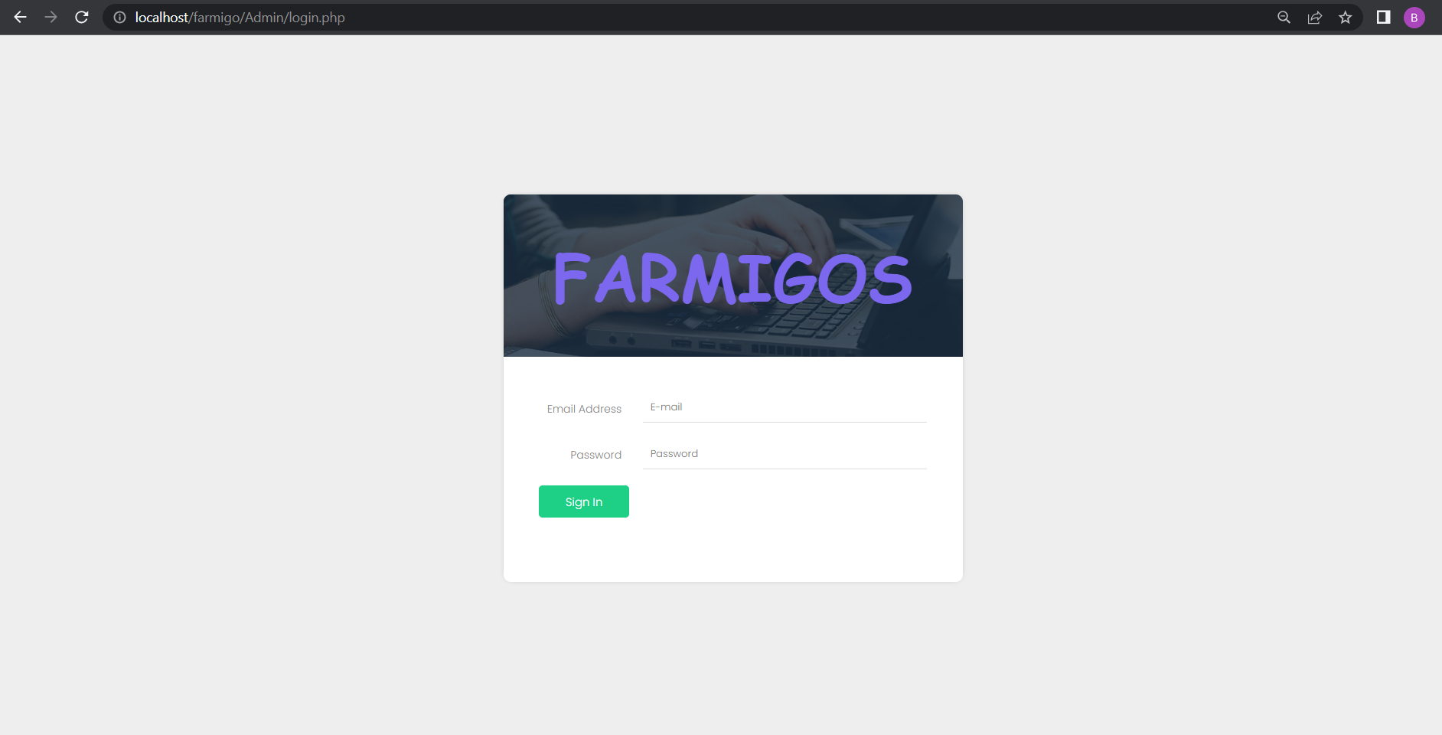
User interface
Admin login page

Slide 17
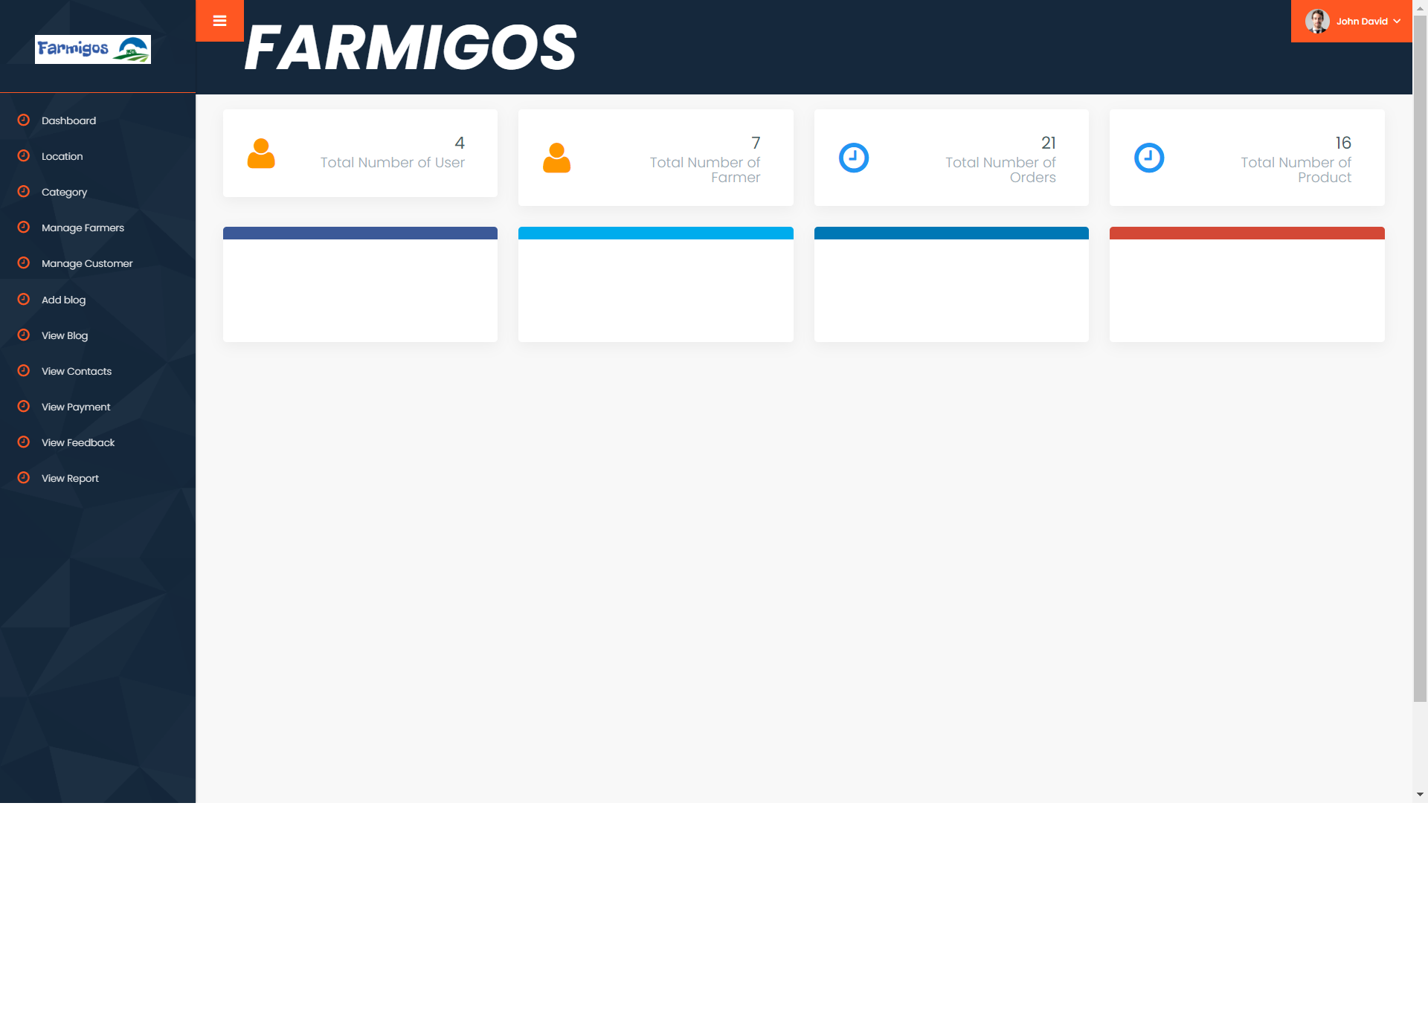
Admin home page

Slide 18
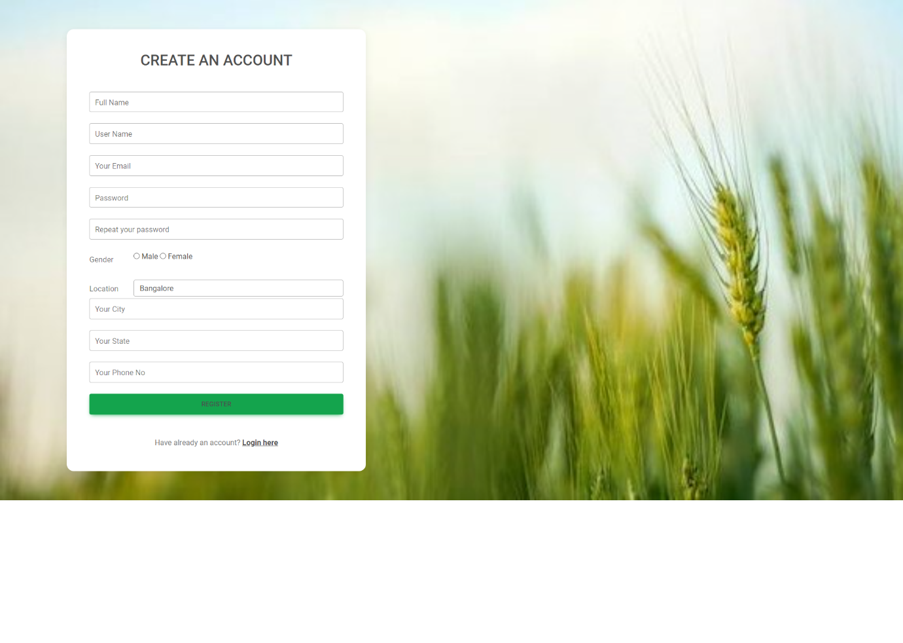
Farmer register page

Slide 19
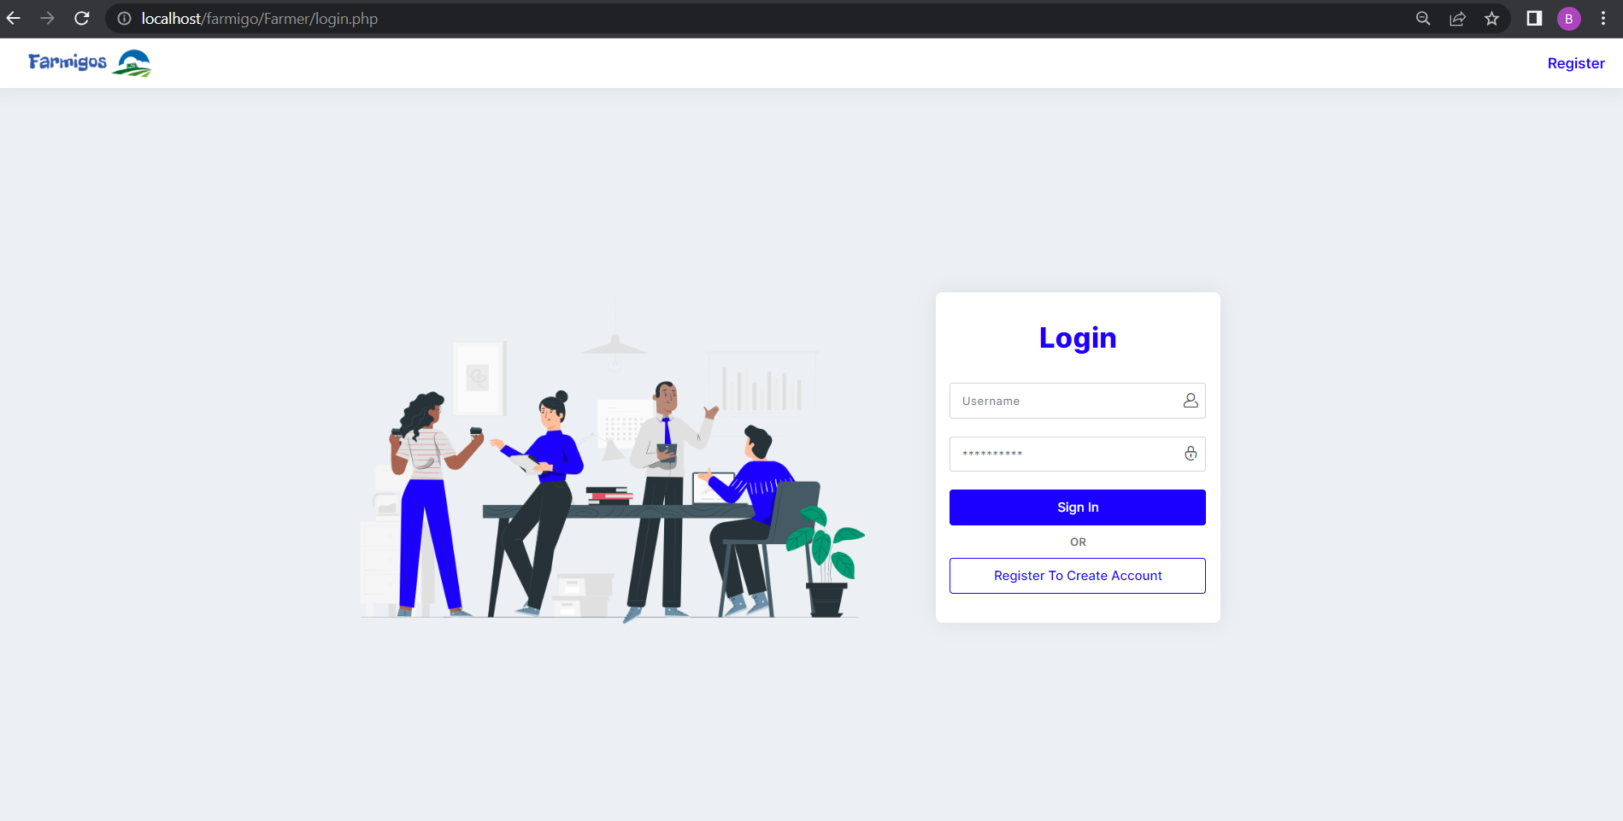
Farmer login page

Slide 20
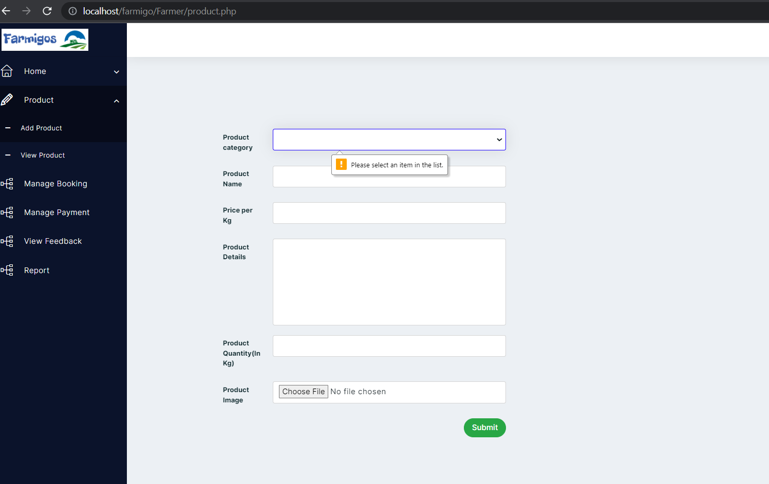
Farmer add product

Slide 21
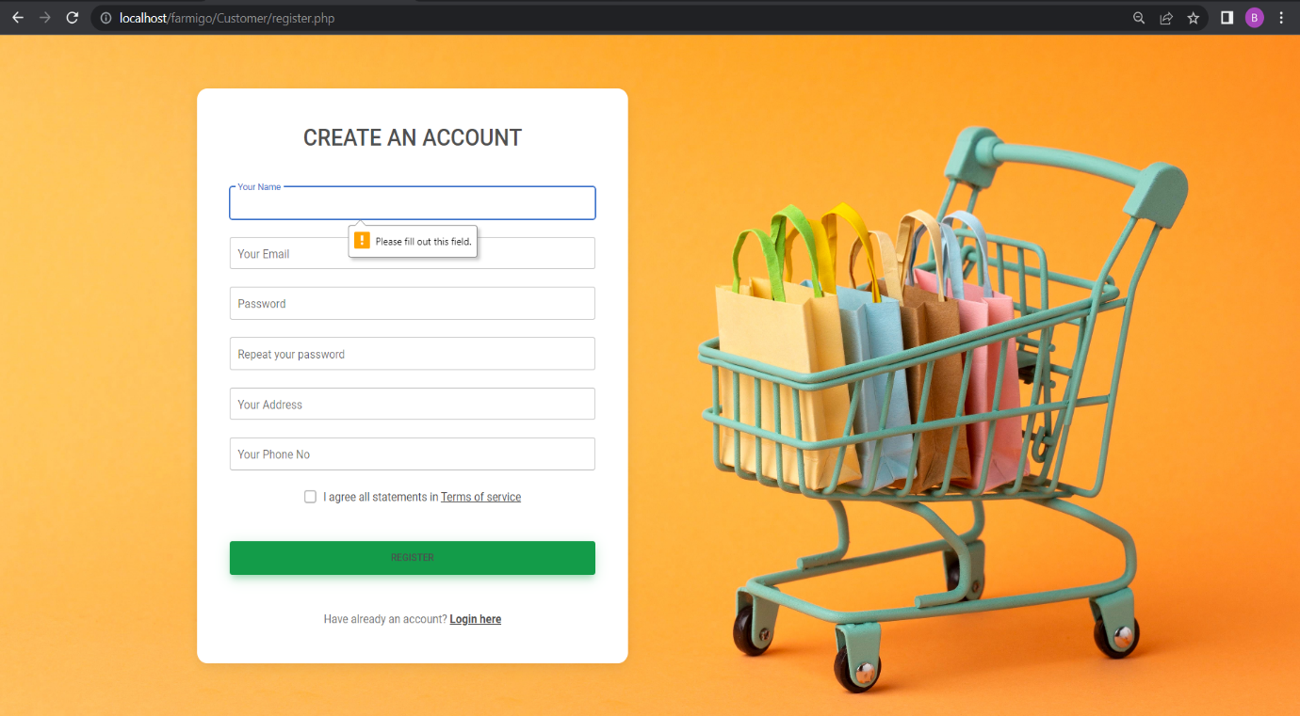
Customer register page

Slide 22
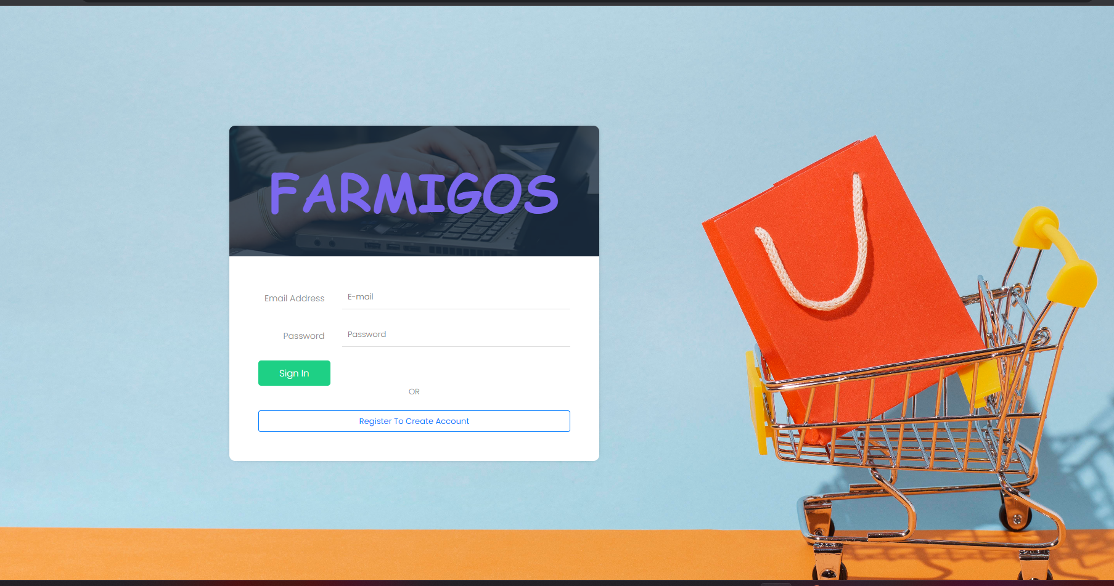
Customer login page

Slide 23
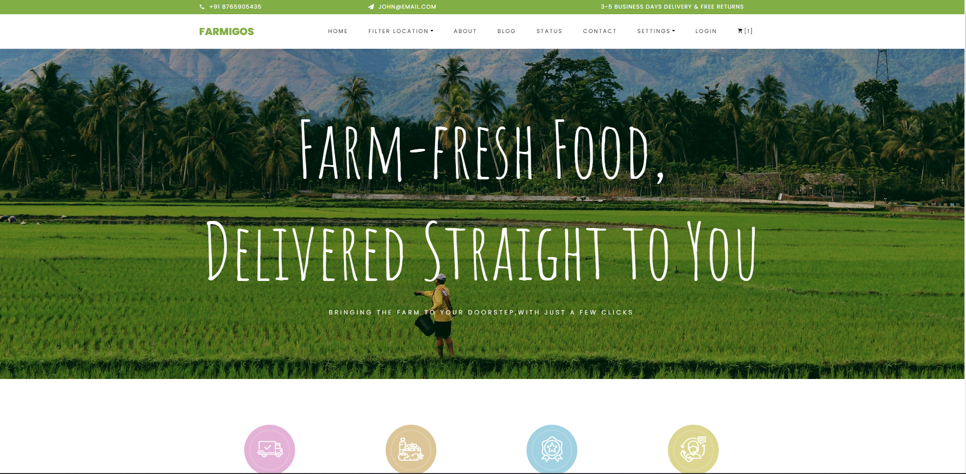
Home page of customer

Slide 24
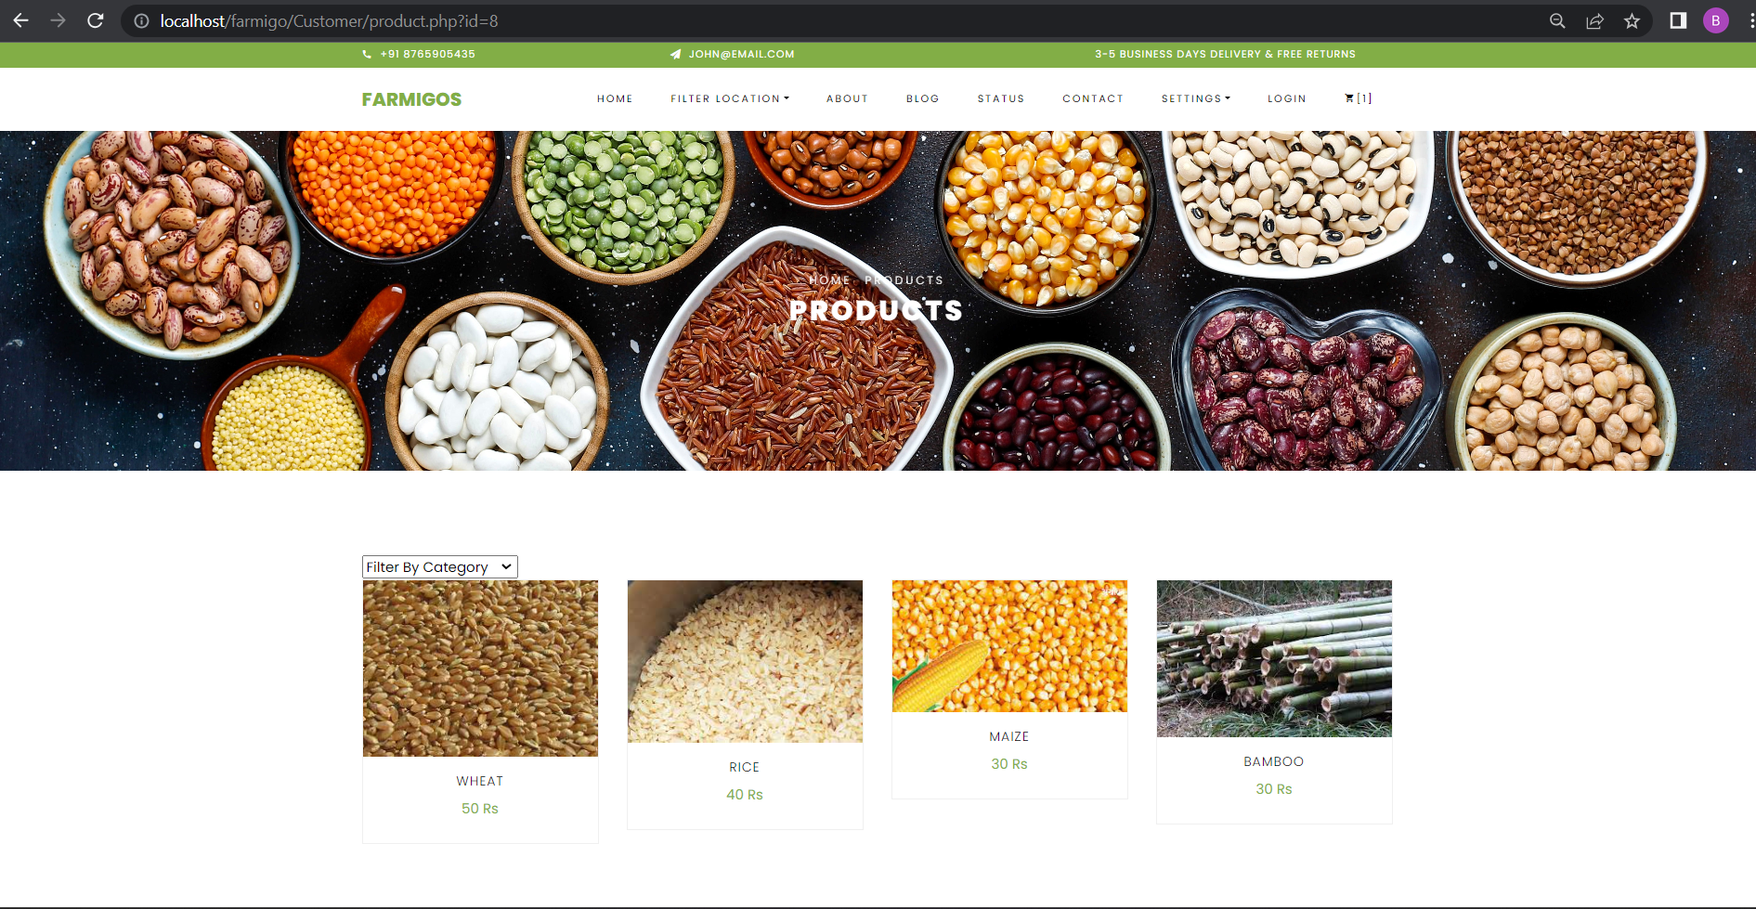
Customer product view page

Slide 25
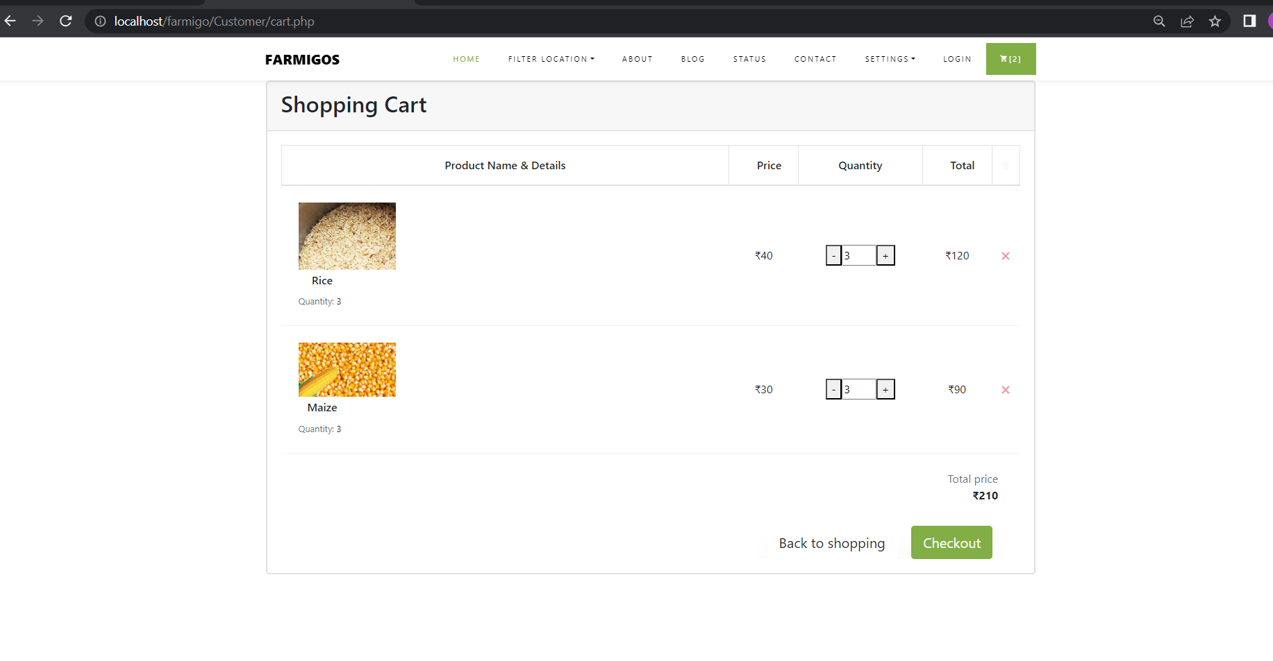
Add to cart

Slide 26
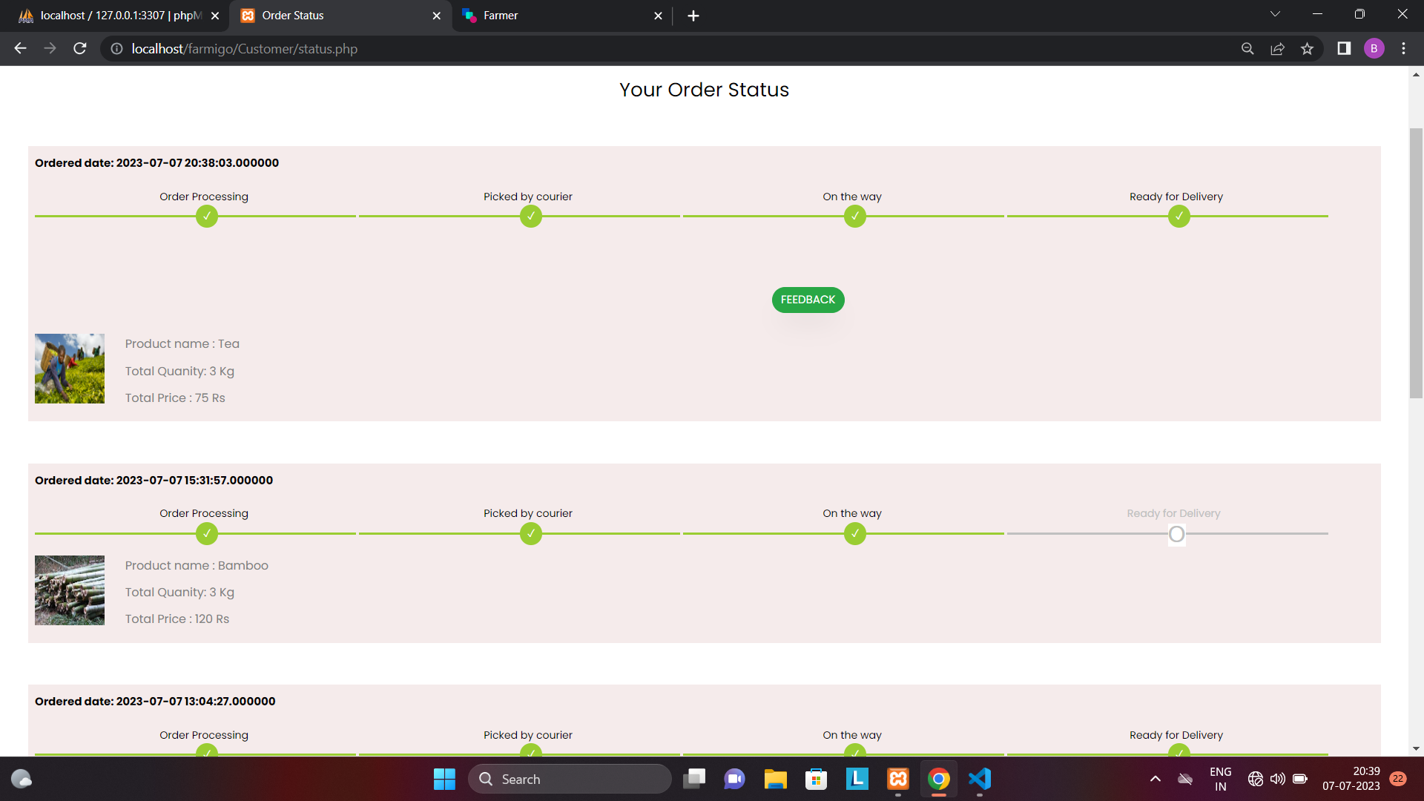
Purchase status view

Slide 27
Limitations
It requires reliable internet access.
It will be difficult for some users because lack of computer and internet knowledge.
Some farmers may be reluctant to participate in the agro market system due to various reasons, such as lack of trust, lack of awareness, and fear of losing control over their produce.
Future scope
In future, it can also be converted to an mobile application.
Establishing linkages with international markets to increase exports and generate foreign exchange

Slide 28
THANK YOU

